Slide 1

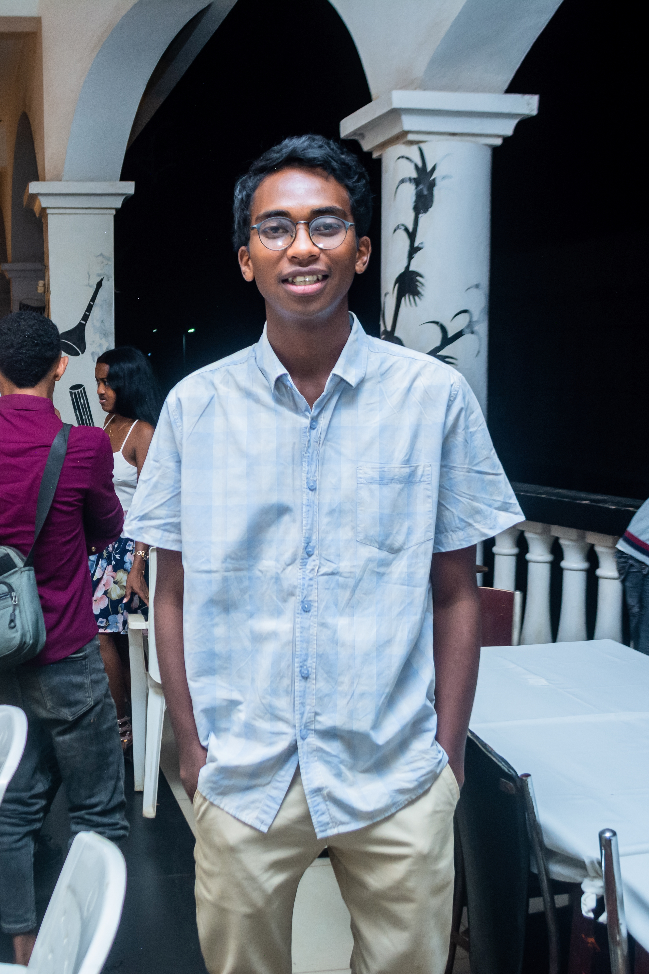
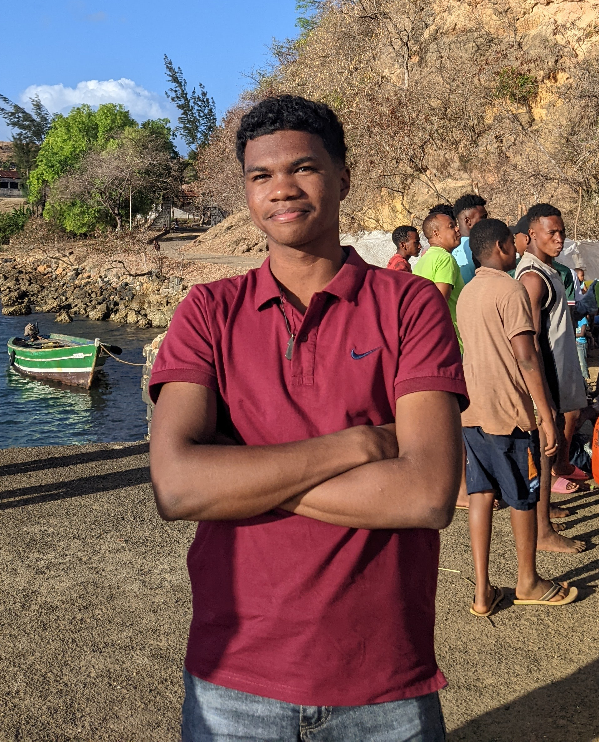
IT DOA WORDPRESS 2025
ANDRIAMAHAVITA Norman Ludovic
TINOGNY Yonni

